Slide 1
Camera module supported API'S
Presented by
M.MOUNIKA
C.KEERTHI KUMARI
T.BEERASWAMY

Slide 2
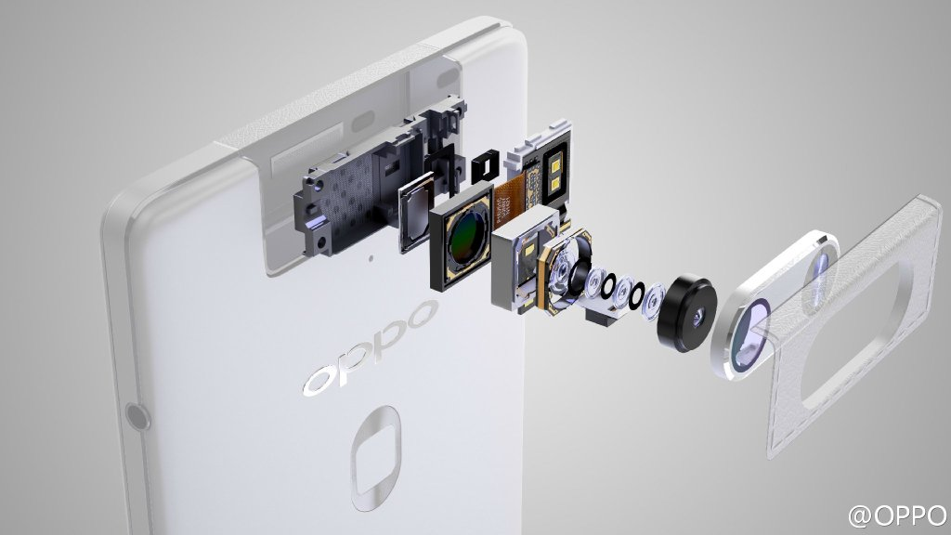
Introduction

Slide 3
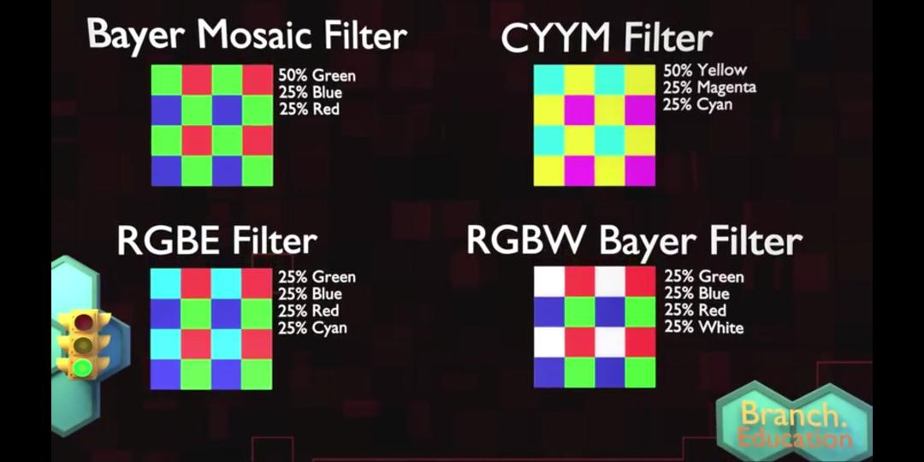

Slide 4
Is Camera loaded statically or dynamically?
Continued...
2

Slide 5
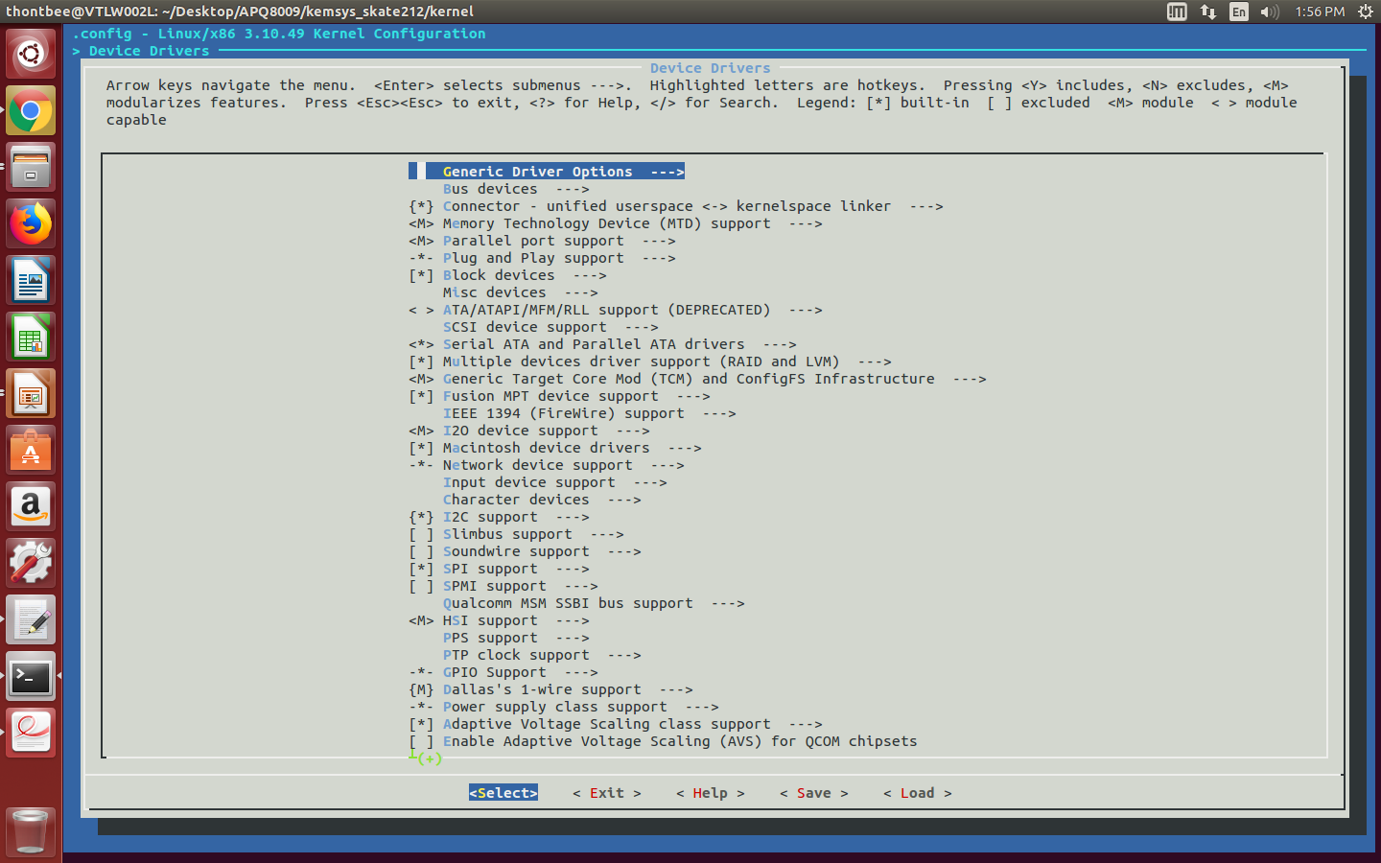
GUI after make menuconfig...

Slide 6
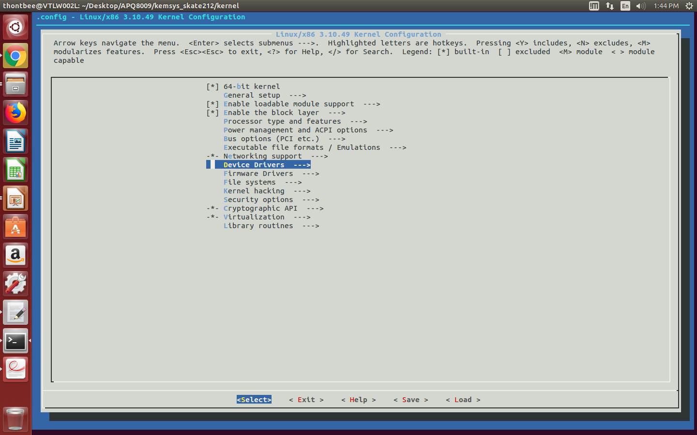
To know the presence of camera driver for ov8865 sensor.

Slide 7
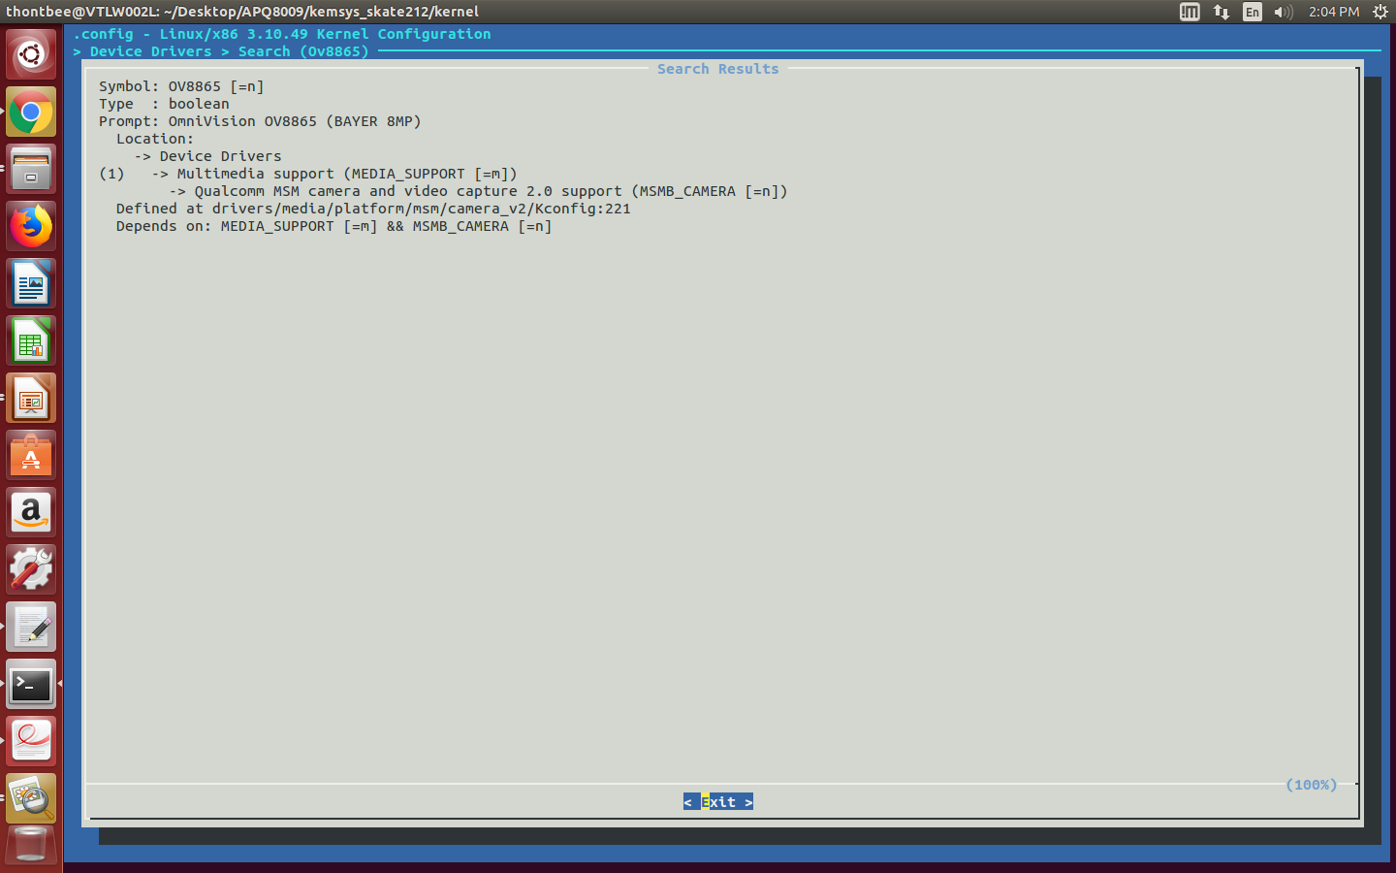
GUI config file for ov8865

Slide 8
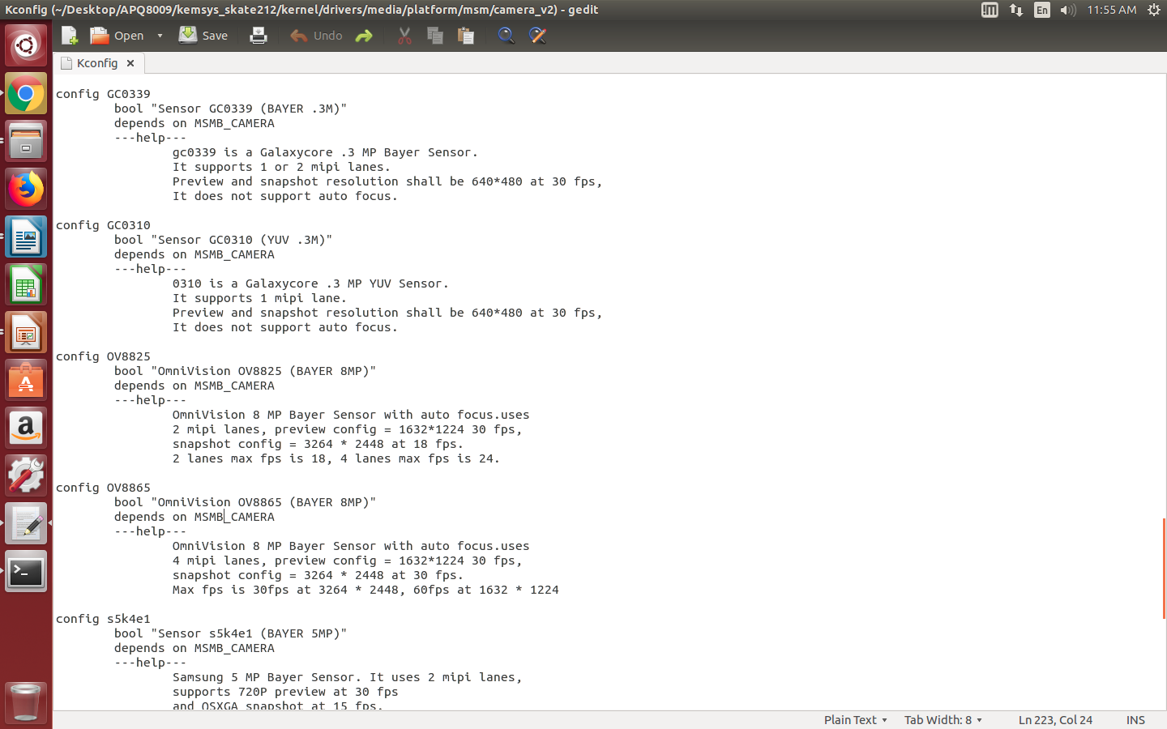
kconfig file for ov8865

Slide 9
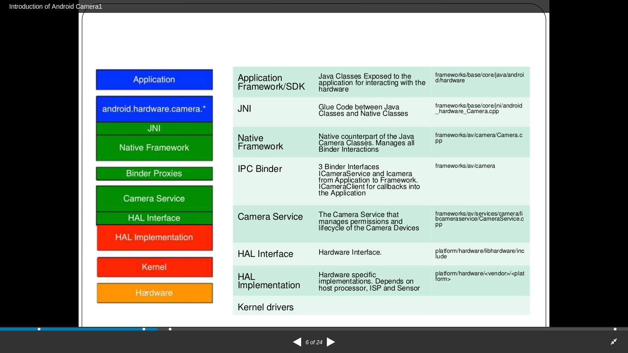
Architecture path of camera module
2
3

Slide 10
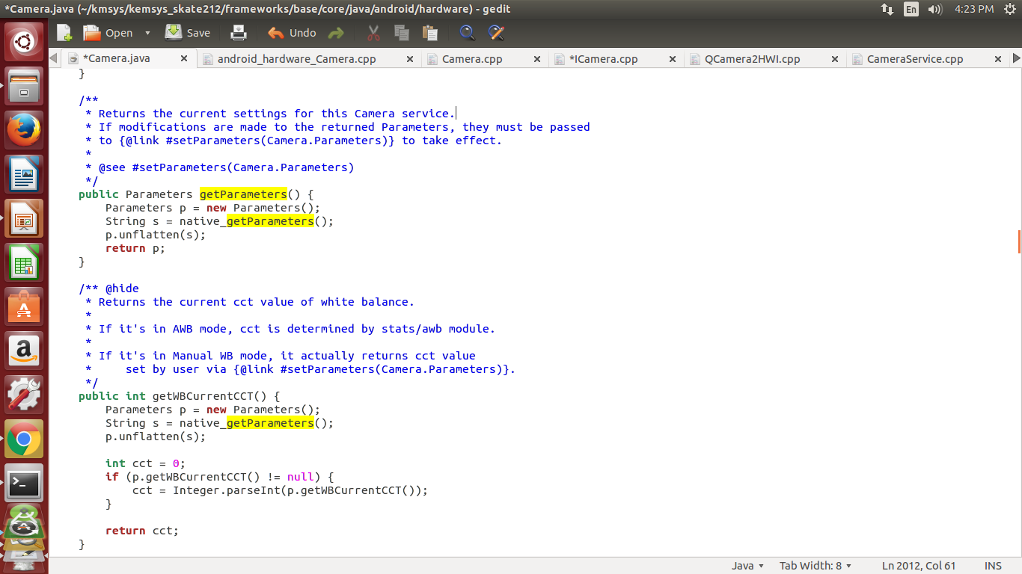
Appliction ---Framwork/base/core/java/android/hardware/camera.java

Slide 11
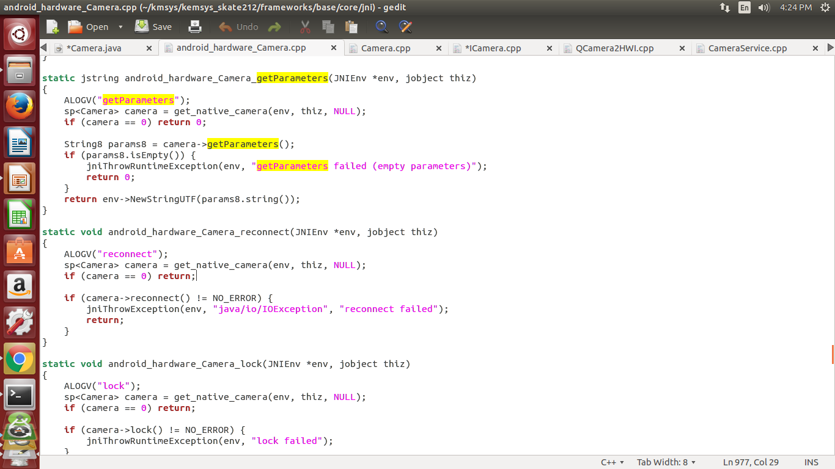
JNI ----Framwork/base/core/jni/android_hardware_camera.cpp

Slide 12
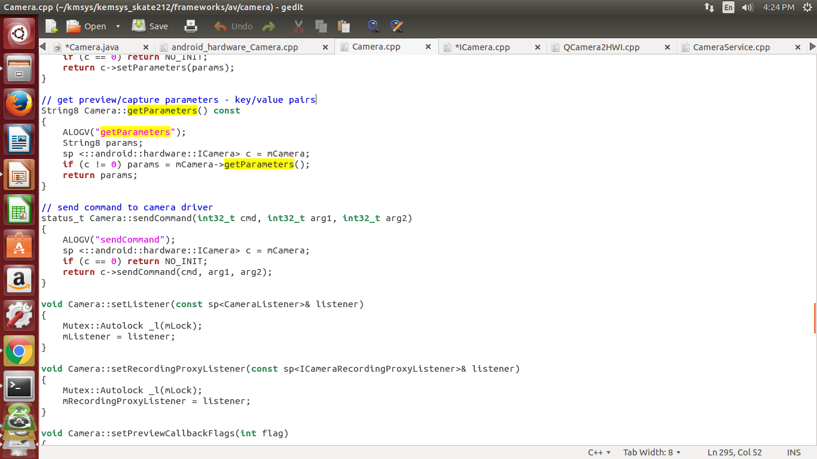
Native framwork---Framework/av/camera/camera.cpp

Slide 13
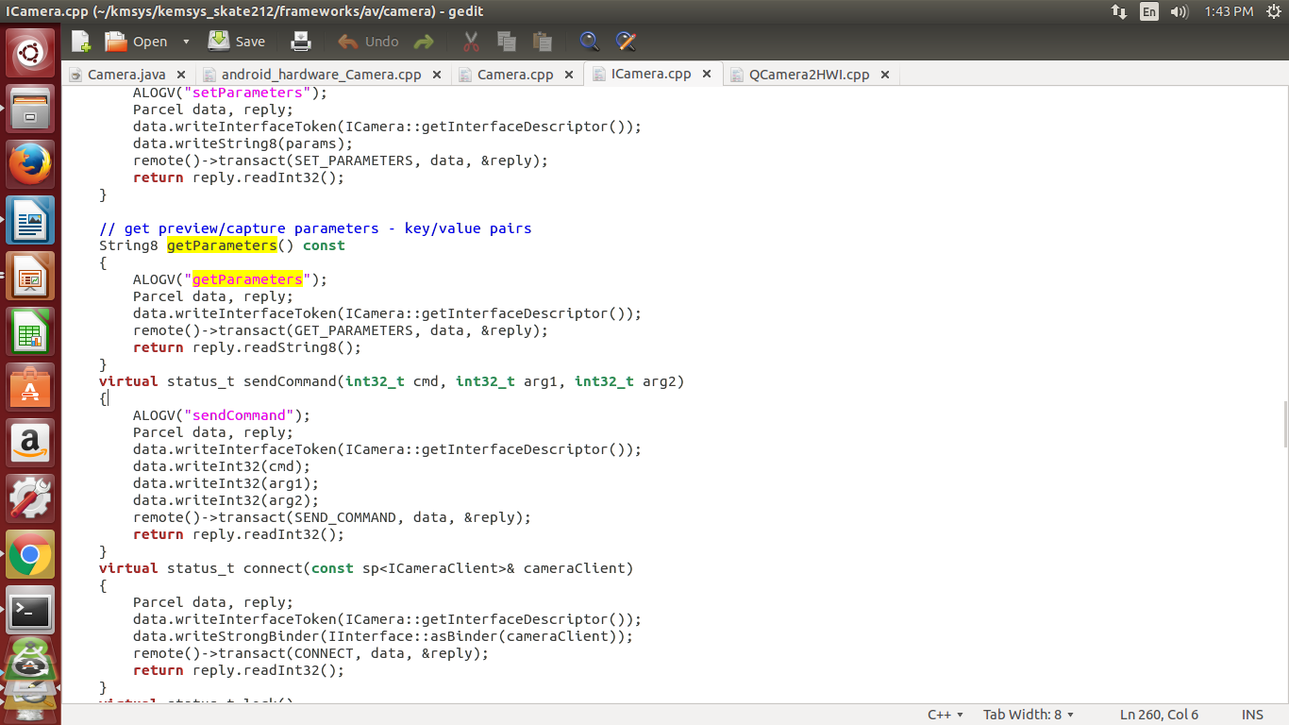
Binder---Framworks /av/ camera/icamera.cpp

Slide 14
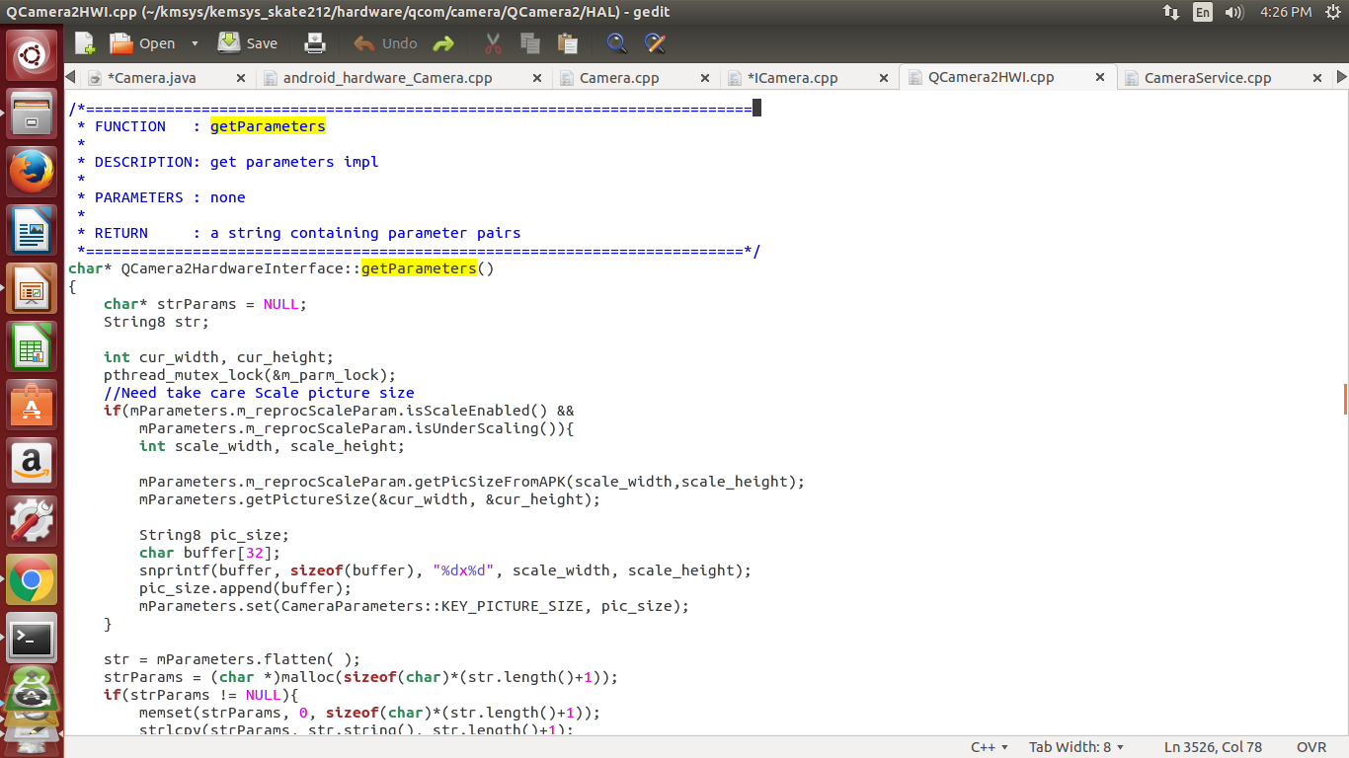
HAL---Hardware/<qcom>/camera/Qcamera2/HAL/Qcamera2HWI.cpp

Slide 15
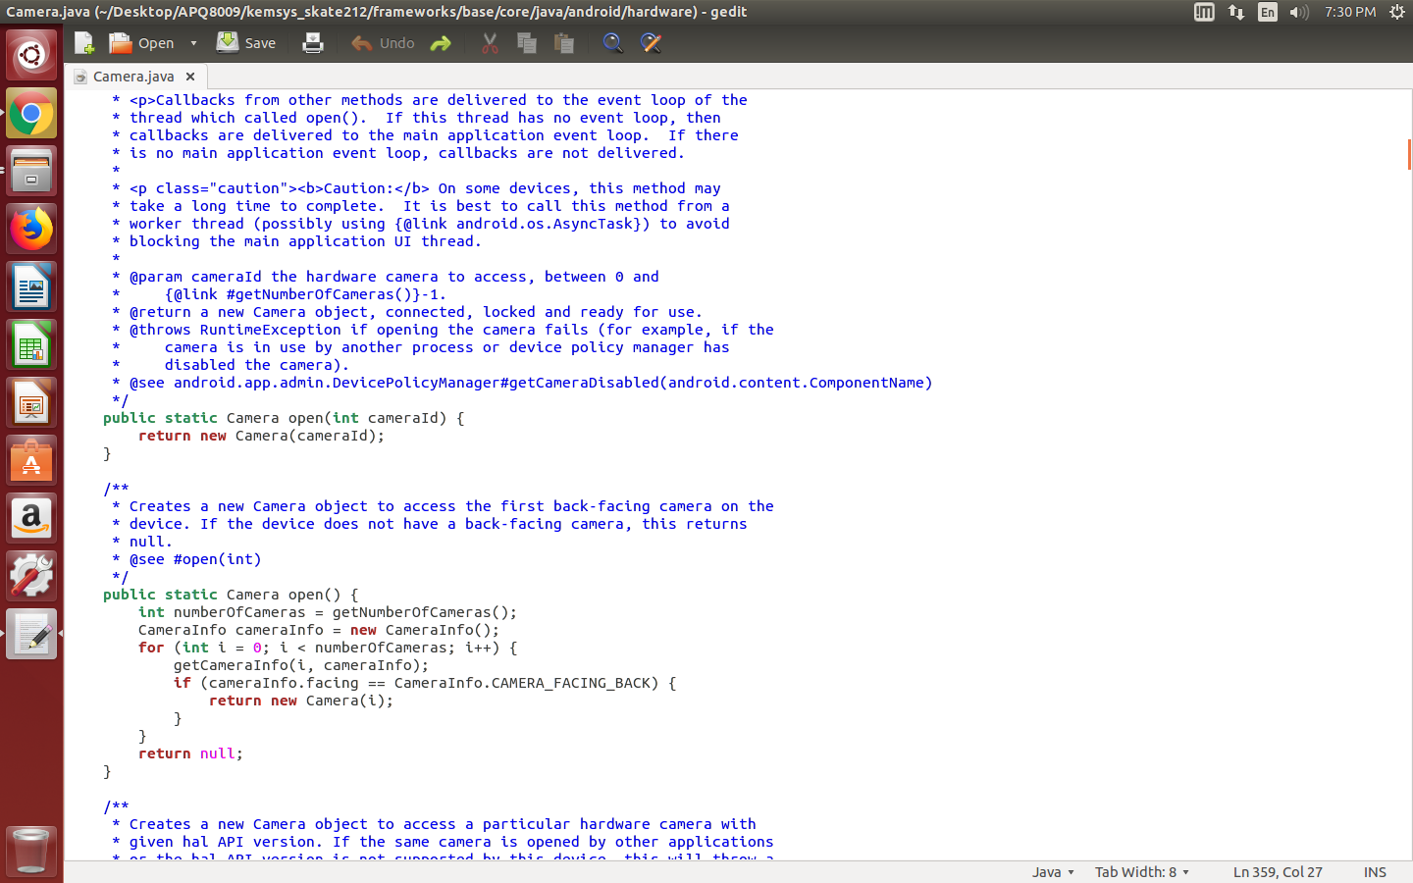
Framwork/base/core/java/android/hardware/camera.java

Slide 16
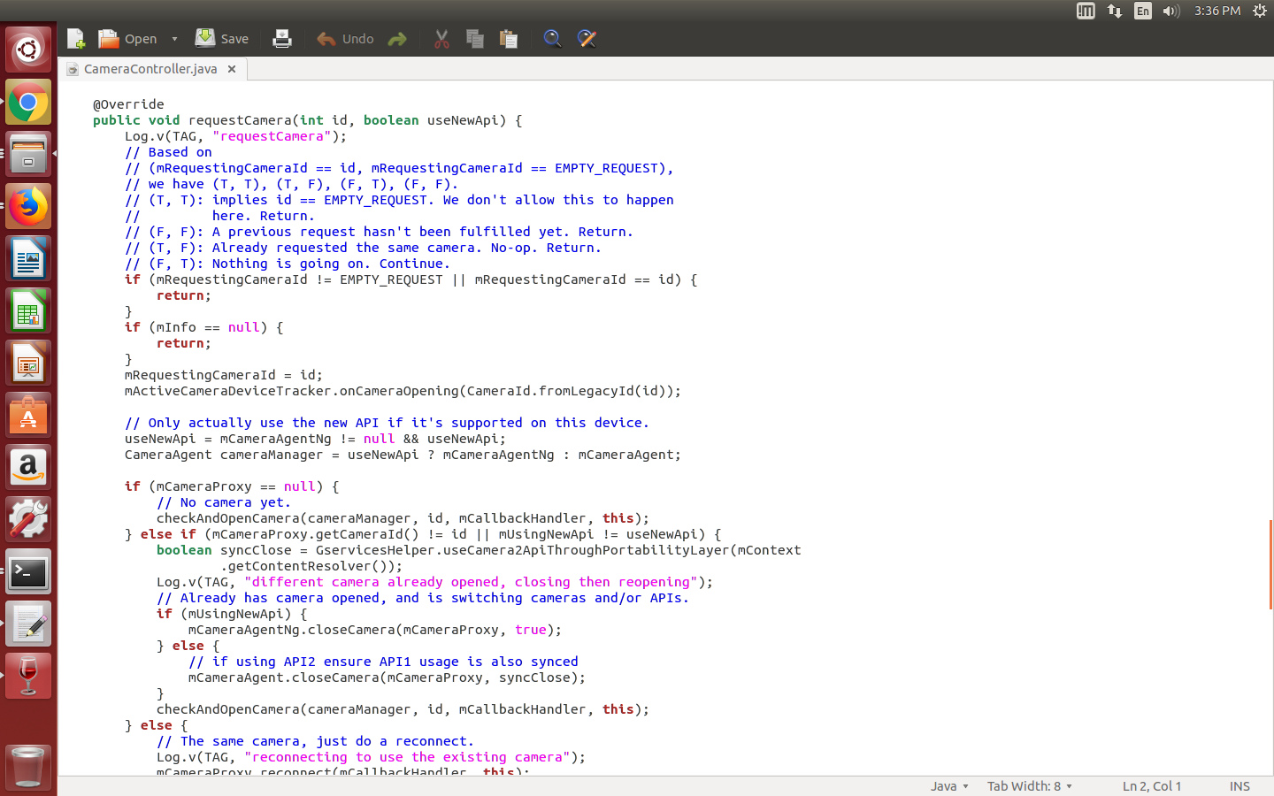
Desktop/APQ8009/kemsys_skate212/packages/apps/Camera2/src/com/android/camera/app/CameraController.java
Continued...
3

Slide 17
5

Slide 18
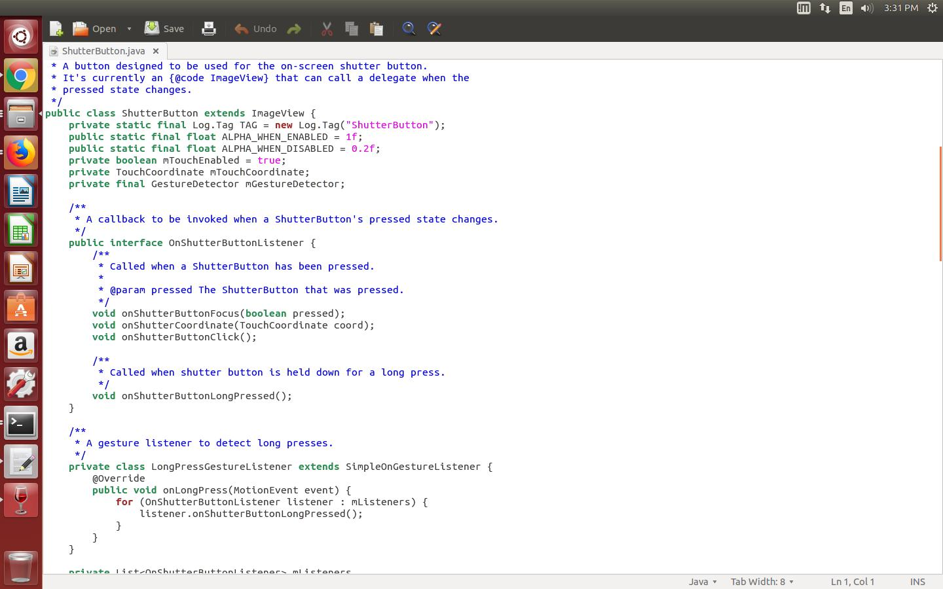
home/thontbee/Desktop/APQ8009/kemsys_skate212/packages/apps/Camera2/src/com/android/camera/ShutterButton.java
Continued...
5

Slide 19
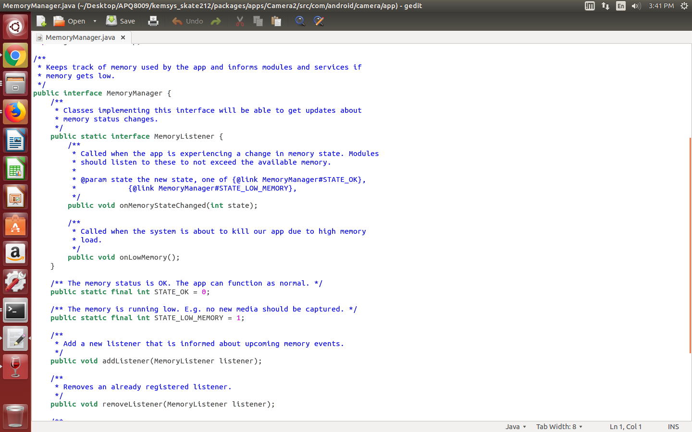
home/thontbee/Desktop/APQ8009/kemsys_skate212/packages/apps/Camera2/src/com/android/camera/ShutterButton.java

Slide 20
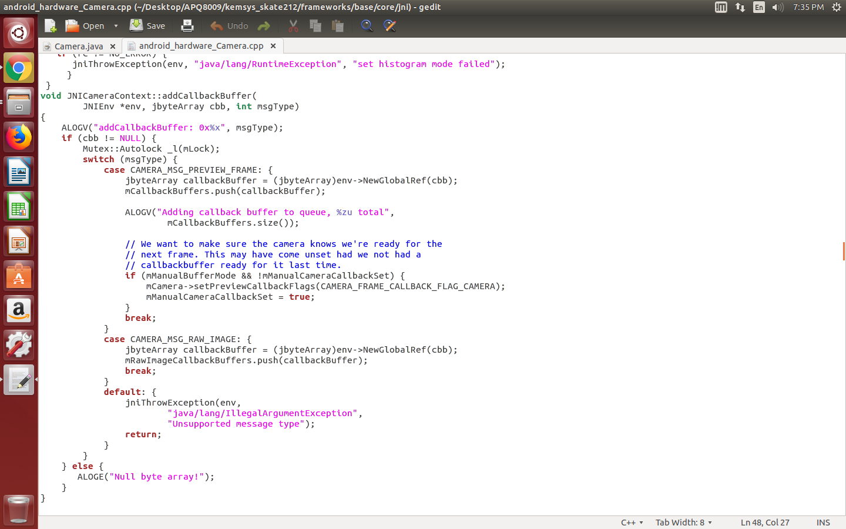
home/thontbee/Desktop/APQ8009/kemsys_skate212/framework/base/core/jni/android_hardware_camera.cpp

Slide 21
home/thontbee/Desktop/APQ8009/kemsys_skate212/packages/apps/Camera2/src/com/android/camera/ShutterButton.java

Slide 22
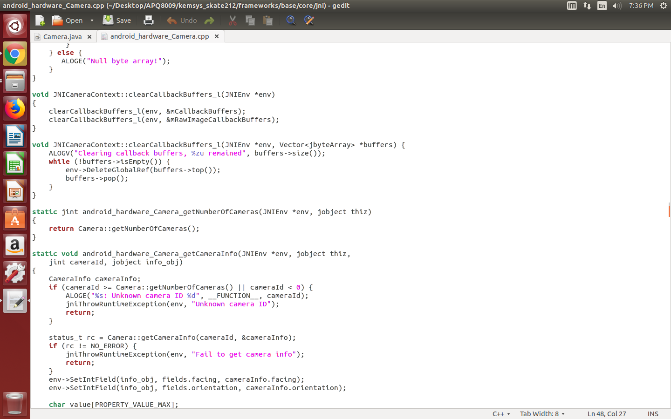
home/thontbee/Desktop/APQ8009/kemsys_skate212/framework/base/core/jni/android_hardware_camera.cpp

Slide 23
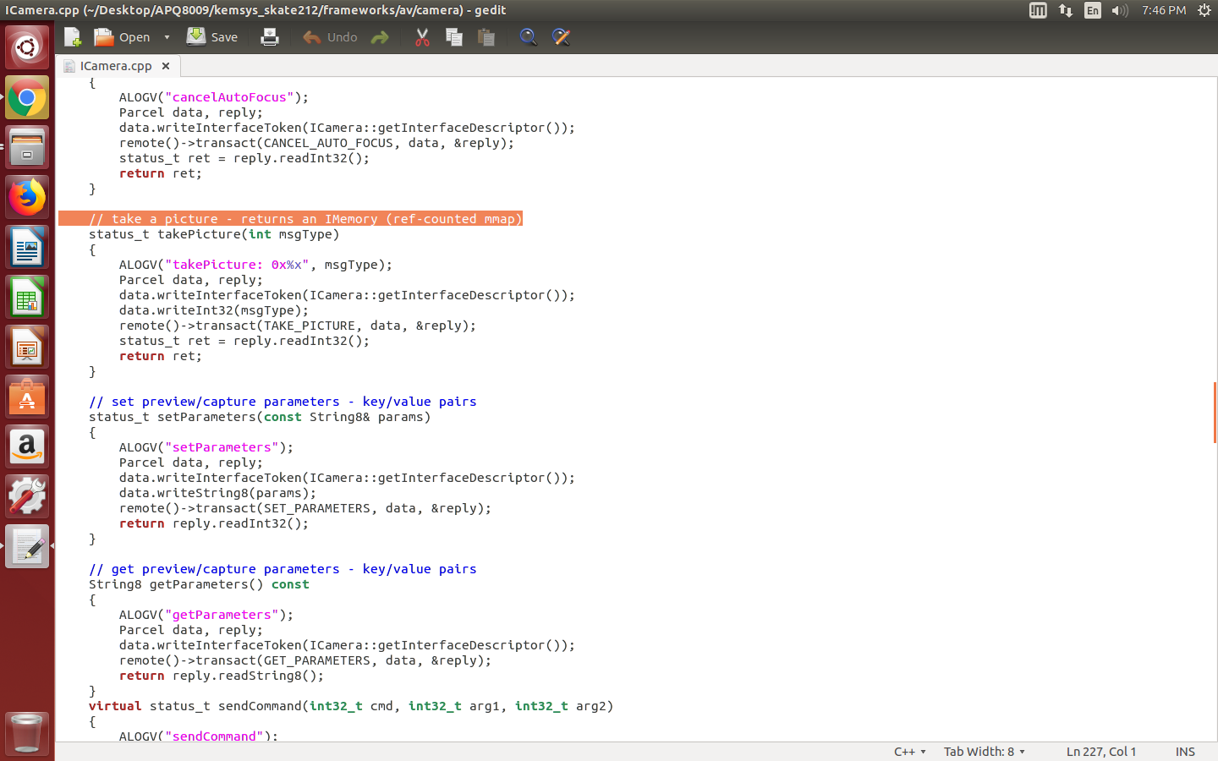
home/thontbee/Desktop/APQ8009/kemsys_skate212/framework/av/camera/Icamera.cpp

Slide 24
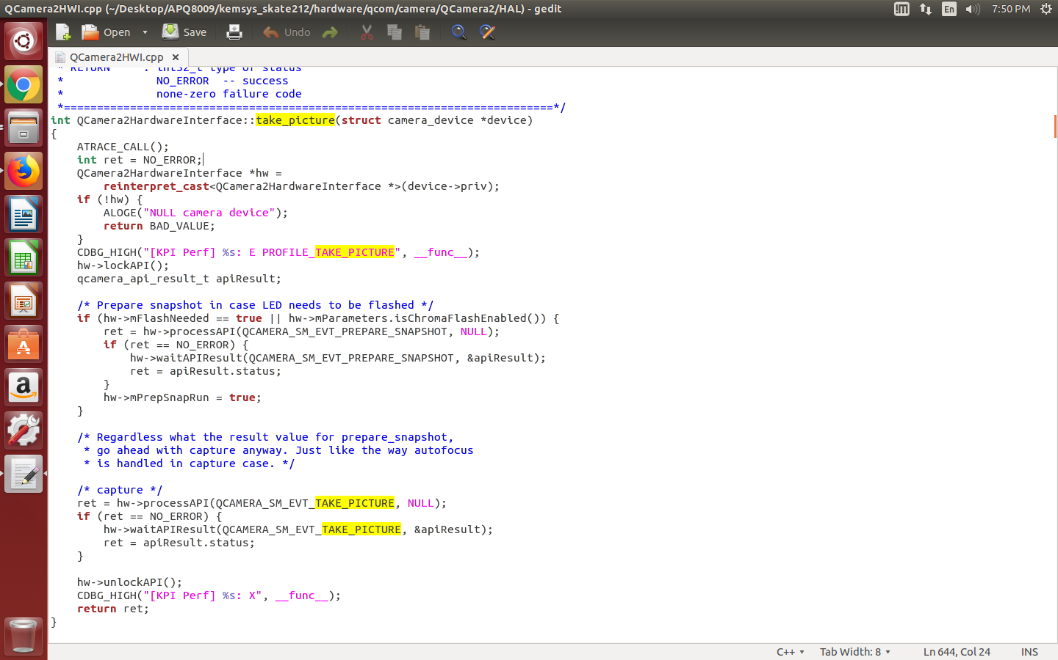
home/thontbee/Desktop/APQ8009/kemsys_skate212/hardware/qcom/camera/Qcamera2/HAL/Qcamera2HWI.cpp

Slide 25
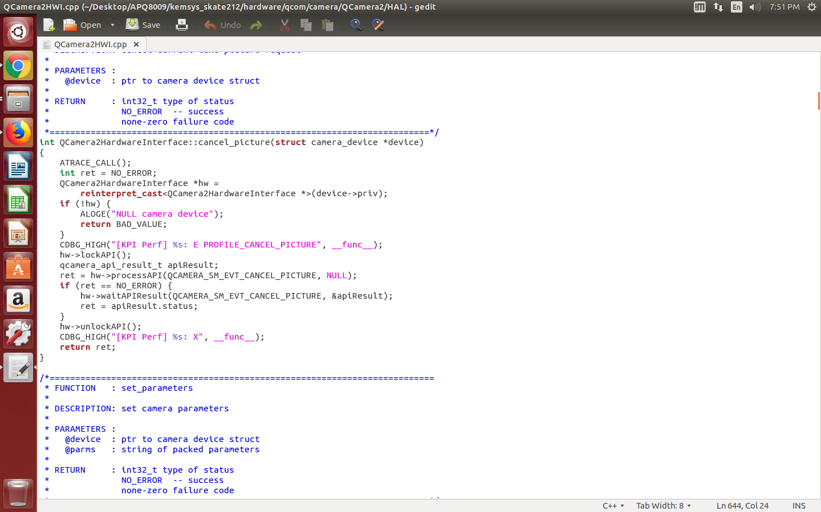

Slide 26
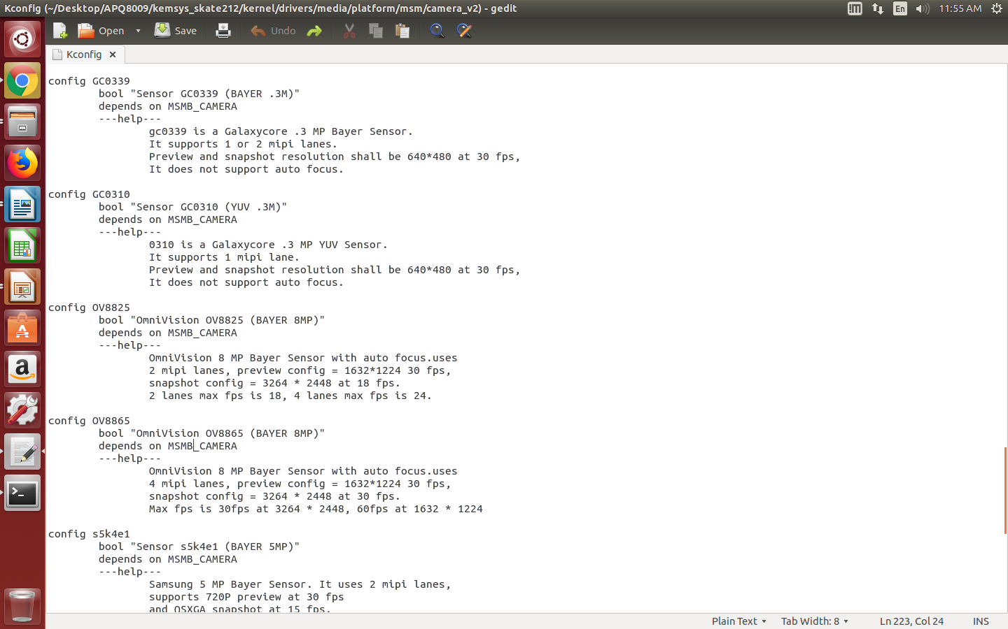
home/thontbee/Desktop/APQ8009/kemsys_skate212/kernel/drivers/media/platform/msm/camera_v2/Kconfig

Slide 27
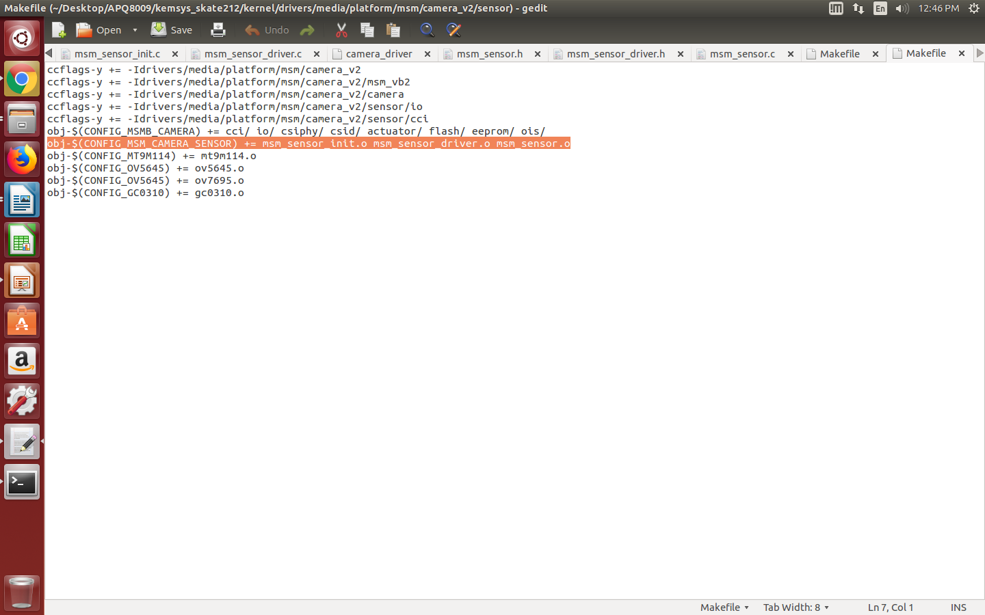
home/thontbee/Desktop/APQ8009/kemsys_skate212/kernel/drivers/media/platform/msm/camera_v2/sensor/Makefile

Slide 28
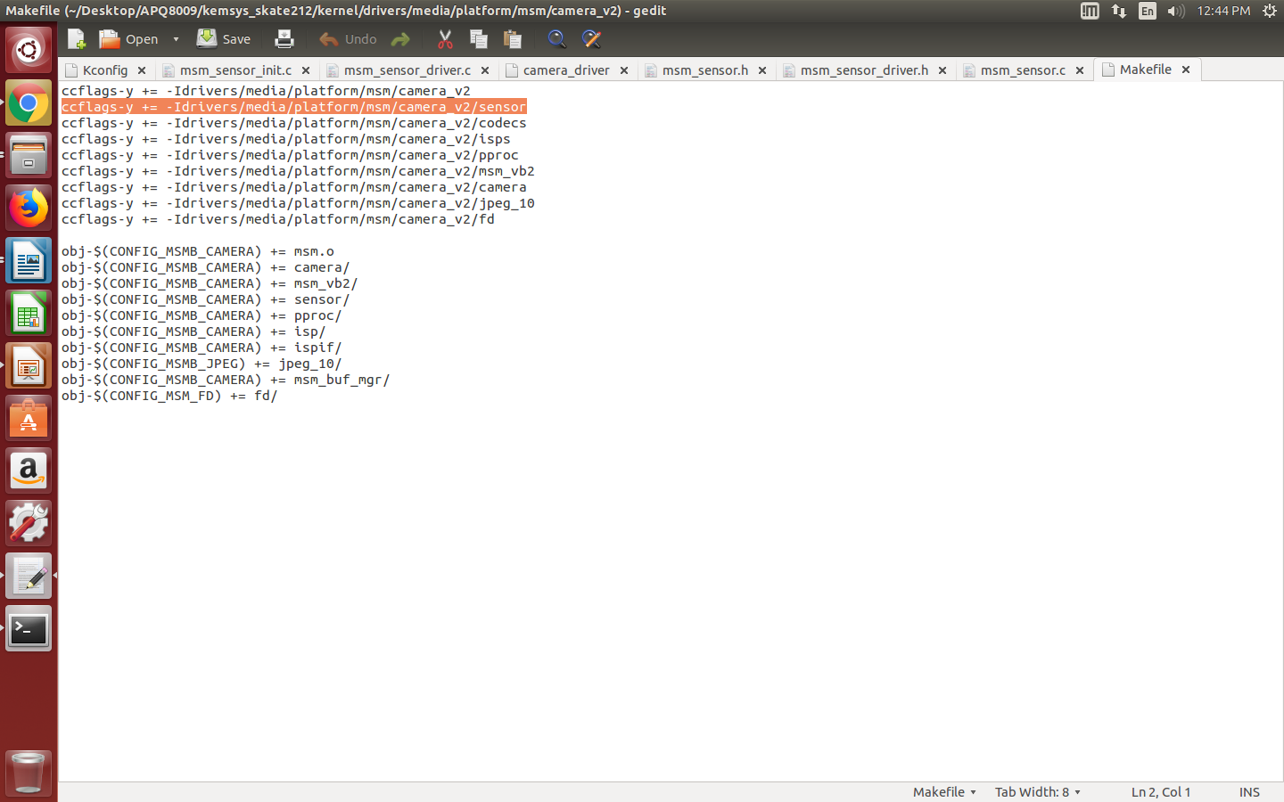
home/thontbee/Desktop/APQ8009/kemsys_skate212/kernel/drivers/media/platform/msm/camera_v2/Makefile

Slide 29
Platform CMOS driver code
home/thontbee/Desktop/APQ8009/kemsys_skate212/kernel/drivers/media/platform/msm/camera_v2/sensor/msm_sensor.c & msm_sensor_driver.c & msm_sensor_init.c

Slide 30

Thank you
8

